Slide 1
Indoor anti-overcrowding system
Based on Node-Red, BLE and MQTT

Slide 2


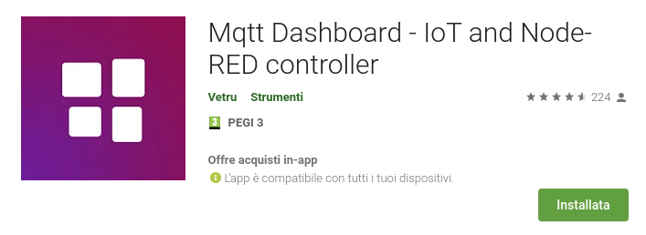
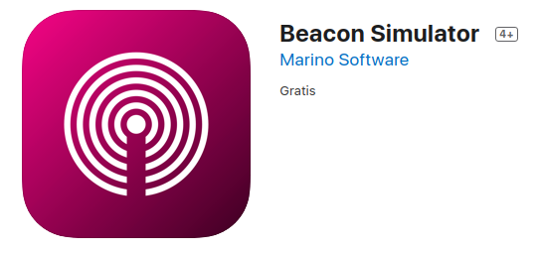
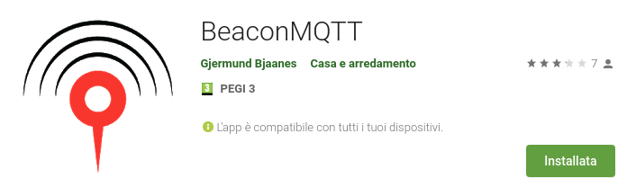
Software used for development

Slide 3
Software used for development
Used as main framework for the project and as a webserver directly with a dedicated dashboard for both real time data and statistical-historical data. It also hosts the MQTT broker (Aedes).

Slide 4
Software used for development
Android app used to simulate the BLE scanner. It has the possibility to save known beacons and to publish MQTT notifications whenever a known beacon enters or exit the area with two respective and different topics.

Slide 5
Software used for development
Android app that can be used to see in real time the state of every room of the building through MQTT notifications (available, full, overcrowded). The user receive a notification every time a room change his state.

Slide 6
Software used for development
IOS app used to simulate a real beacon in order to test the system.

Slide 7
Software used for development
MySQL is the DBMS that is used to manage the system database. The database consists in 2 tables, one is used as a log that register every detection-exit for every room, the is used as a log to keep trace of the overcrowd alarms that have been triggered.

Slide 8



Interaction map
MQTT
localhost
Scanner
Database
Server
MQTT
User (beacon + mqtt dashboard)

Slide 9
Testing the system
Since it is quite difficult to find many devices to simulate both beacons and scanners, once i found out that the system worked with one real beacon and two real scanners I created many injectors on node-red that behaves exactly as the original interaction between scanners and beacons, so they inject the same exact payload that is received through MQTT notifications with the real system (the payload contains the detected/lost beacon UUID). In order to test the system I used 3 fake beacons travelling through 2 rooms of the building (bedroom and gate).

Slide 10
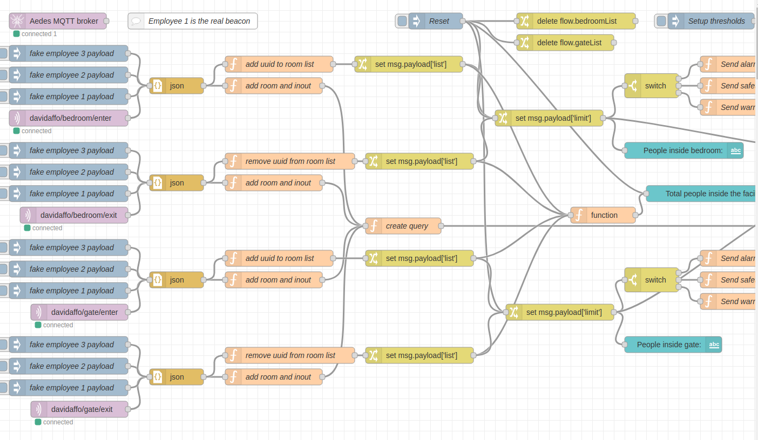
Testing the system

Slide 11
Dashboard
The dashboard is divided in two parts, one for the real time data, the other for interact with historical data and obtain some statistics.

Slide 12
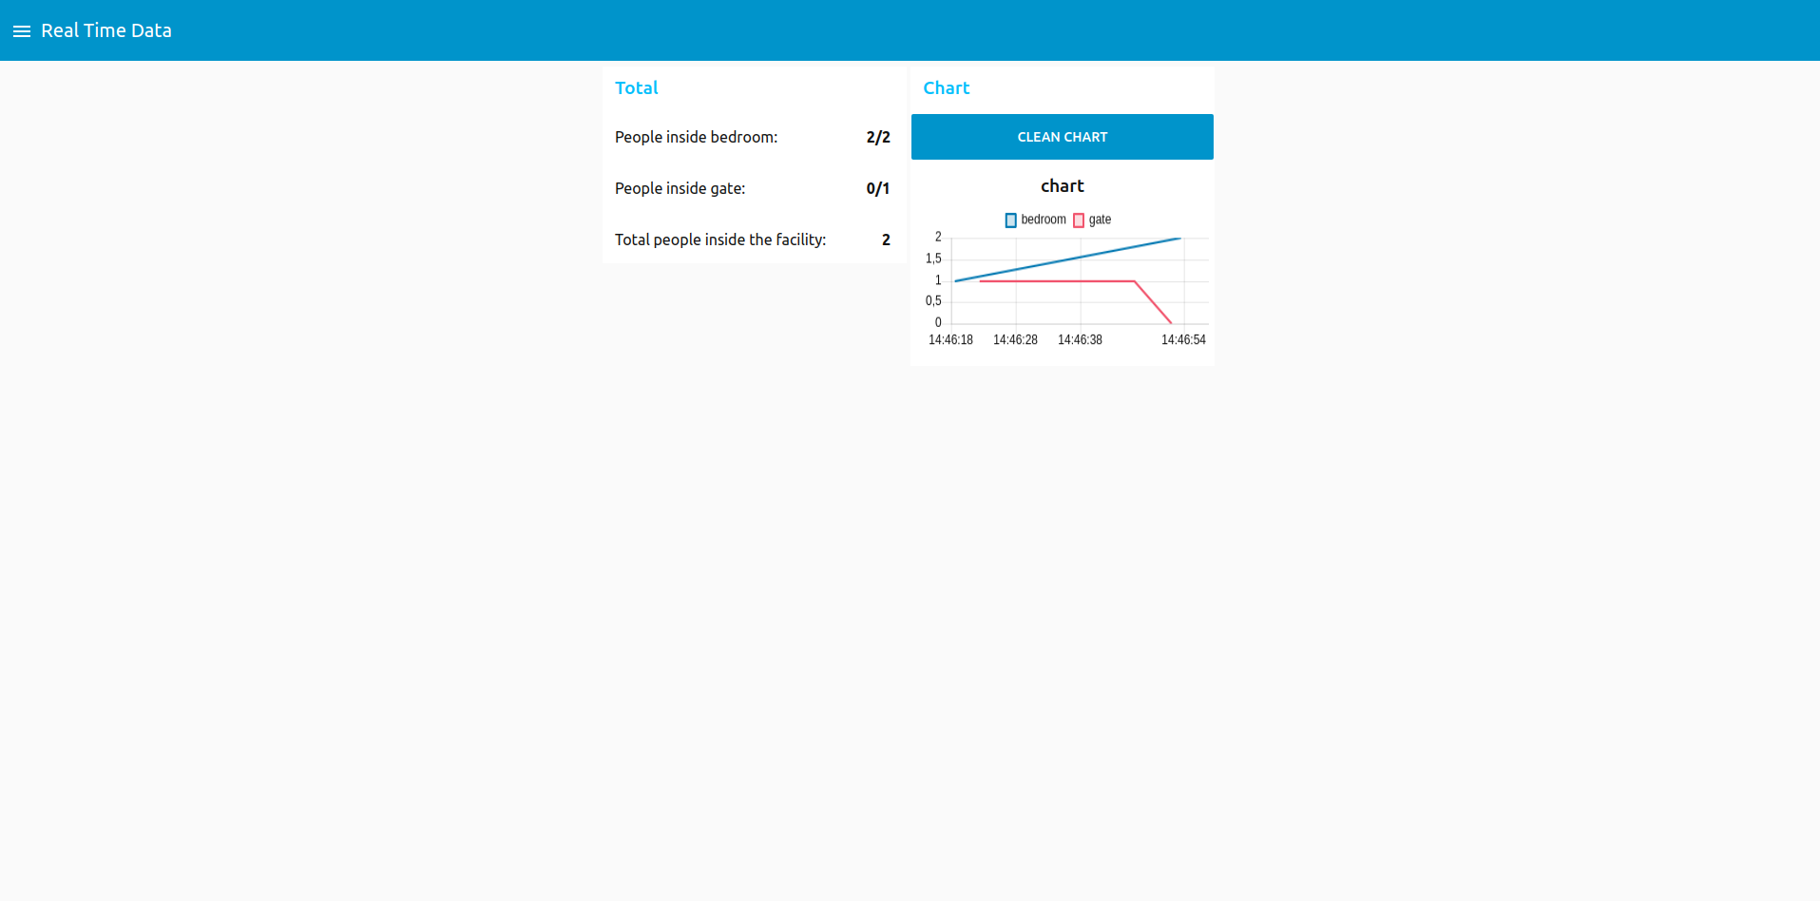
Dashboard - Real time data
This tab contains real time data, showing the actual status of the facility (also with a graphical chart)

Slide 13
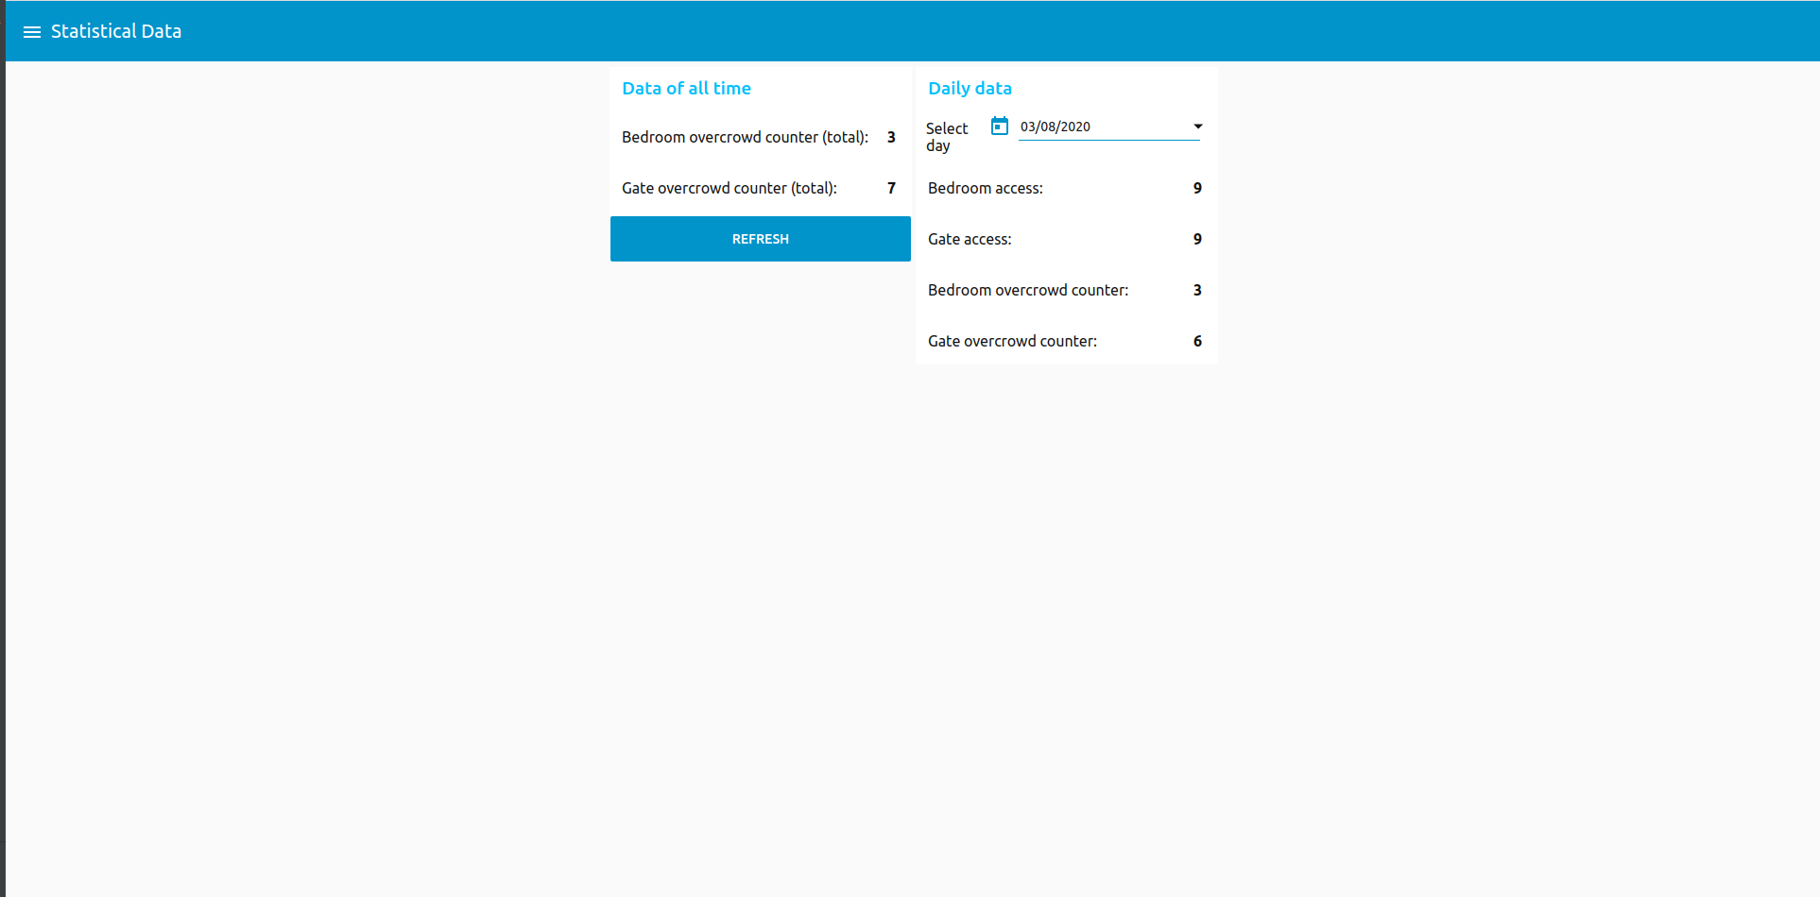
Dashboard - Statistical/Historical Data
This tab permits to interact with the historical data in the database, showing statistic of all time or filtered by day:

